Slide 1
地學通論(2)
翁叔平老師: znspw302@ntnu.edu.tw
Tel: 77491633;地理系927研究室
Office Hours: Tuesdays 17:30-18:30 and Fridays 10:00-11:00 (or make appointment)
Textbook: Geosystems: An Introduction to Physical Geography. By R.W. Christopheson. 10th ed. [2017; but any version after 5th ed. (2003) is okay].
sources: 1. Purchase (黎明書局; 重慶南路1段49號; 23310557、 23820613; Miss張; 1,200元左右)
2. Library 總館7F書架;索書號: 910.02 C466(2) 條碼: BM0684033 (for 9th.ed. 2015);索書號: 910.02 C467條碼: B20303038 (for 5th.ed. 2003)
3. Borrow 對學長、學姊好一點!

Slide 2
地學通論(2)
上課的內容(ppt檔)和閱讀指引在那裏?
期中考:日期:11月9日(甲班); 11月12日(乙班) ); 11月10日(丙班)
考試方式 => 筆試
ppt檔: 30%;
閱讀指引: 70%
閱讀指引1: Foundations of Geography; 141 questions
閱讀指引2: Solar Energy, Seasons, and the Atmosphere; 170 questions
閱讀指引3: Atmospheric Energy and Global Temperatures; 130 questions
閱讀指引4: Atmospheric and Oceanic Circulation; 105 questions
閱讀指引5: Atmospheric Water and Weather; 162 questions
閱讀指引6: Water Resources; 83 questions
閱讀指引7: Global Climate Systems; 104 questions
Totally, 895 questions (workload ～ 20 questions/per day)
閱讀指引1: Foundations of Geography; 141 questions
閱讀指引2: Solar Energy, Seasons, and the Atmosphere; 170 questions
閱讀指引3: Atmospheric Energy and Global Temperatures; 130 questions
閱讀指引4: Atmospheric and Oceanic Circulation; 105 questions
閱讀指引5: Atmospheric Water and Weather; 162 questions
閱讀指引6: Water Resources; 83 questions
閱讀指引7: Global Climate Systems; 104 questions
Totally, 895 questions (workload ～ 20 questions/per day)

Slide 3
課程目標
闡述自然地理環境各要素 (地殼、大氣、水文、地形、生物、土壤等) 的性質與特徵，及其間彼此的關聯和作用，讓學習者對於自然地理環境有一整體性的認識，並能了解其分異規則和自然區劃等基本概念。
Notes:
從「知其然」到「知其所以然」
知道事物的表面现象，知道事物的本質及其產生的原因

Slide 4
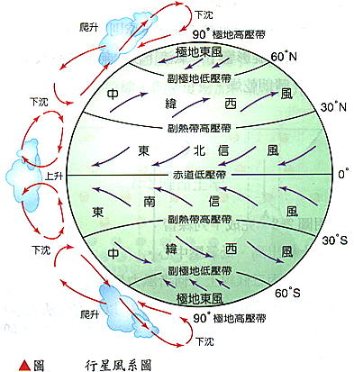
行星風系概念圖

Slide 5
課程目標
闡述自然地理環境各要素 (地殼、大氣、水文、地形、生物、土壤等) 的性質與特徵，及其間彼此的關聯和作用，讓學習者對於自然地理環境有一整體性的認識，並能了解其分異規則和自然區劃等基本概念。

Slide 6
自然地理區劃
依據前述的自然地理環境要素的地域分異(空間分佈的相似性和差異性)而進行的區域劃分，為一定等級的系統性研究方法。
其目的是便於根據不同區域的自然情況考慮如何合理利用與改造自然資源(因地制宜進行生產佈局和制定各種有利人類發展的社經規劃)。
自然地理區劃不必然一成不變﹔它可以再劃分(根據地域分異規律可將等級高的單位劃分成等級低的單位)，也可以反向合併(根據共軛性原則將等級低的單位合併成等級高的單位)。
地理學: 帝國之學
共軛性原則: 地理上有共同規律的單位;通常在空間上具備連續性
Notes:
共軛性原則:地理上有共同規律的單位;通常在空間上具備連續性

Slide 7
Personal Implications (for freshman)
You will need to be self-motivated to complete the course requirements.
Forming a Study Group is one of the most effective and enjoyable methods of learning. It will only be as helpful as you choose to make it.
You will have the opportunity to direct your own learning times and styles. You should, and will learn skills in time management and self-directed learning.

Slide 8
Practical Implications
The workload for this introductory course is equivalent to any other 2 credit hour class offered on campus – approximately 1 hour of reading assigned 7 guidance everyday and 1 hour for studying course lecture after class.
You will be expected to be diligent in order to gain a good grade.
You should frequently chat with the instructor and classmates about course content.
You will need to complete assignments absolutely on time in order that they may be forwarded to the instructor.
You are encouraged to organize a “Study Group” which will meet regularly, in order to work together and help each other understand some difficult concepts the instructor delivers.
Internet access is becoming essential as a source of information relevant to the course.

Slide 9
Your 1st Homework (no need to turn in)
為什麼要有降雨?
降雨如何發生?
為什麼陸表有河流?
為什麼河流會拐彎? 洋流呢 風呢?
Notes:
Jet streams get stuck under GW: https://youtu.be/U9Da-PrBqMU

Slide 10
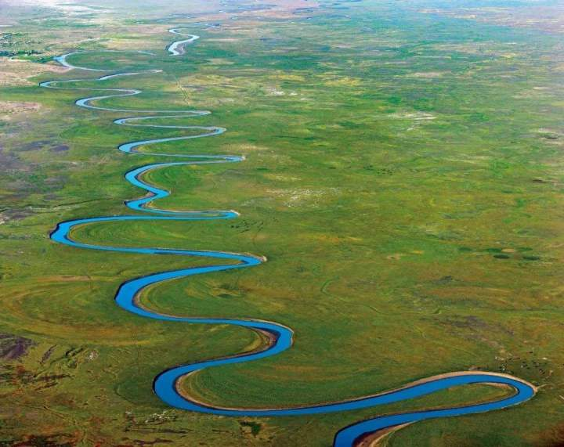
Oxbow river/lake
U形河道/河跡湖，又稱 牛軛湖、馬蹄湖
a curved lake that was originally a bend in a river but became separated when the river took a new, straighter course

Slide 11
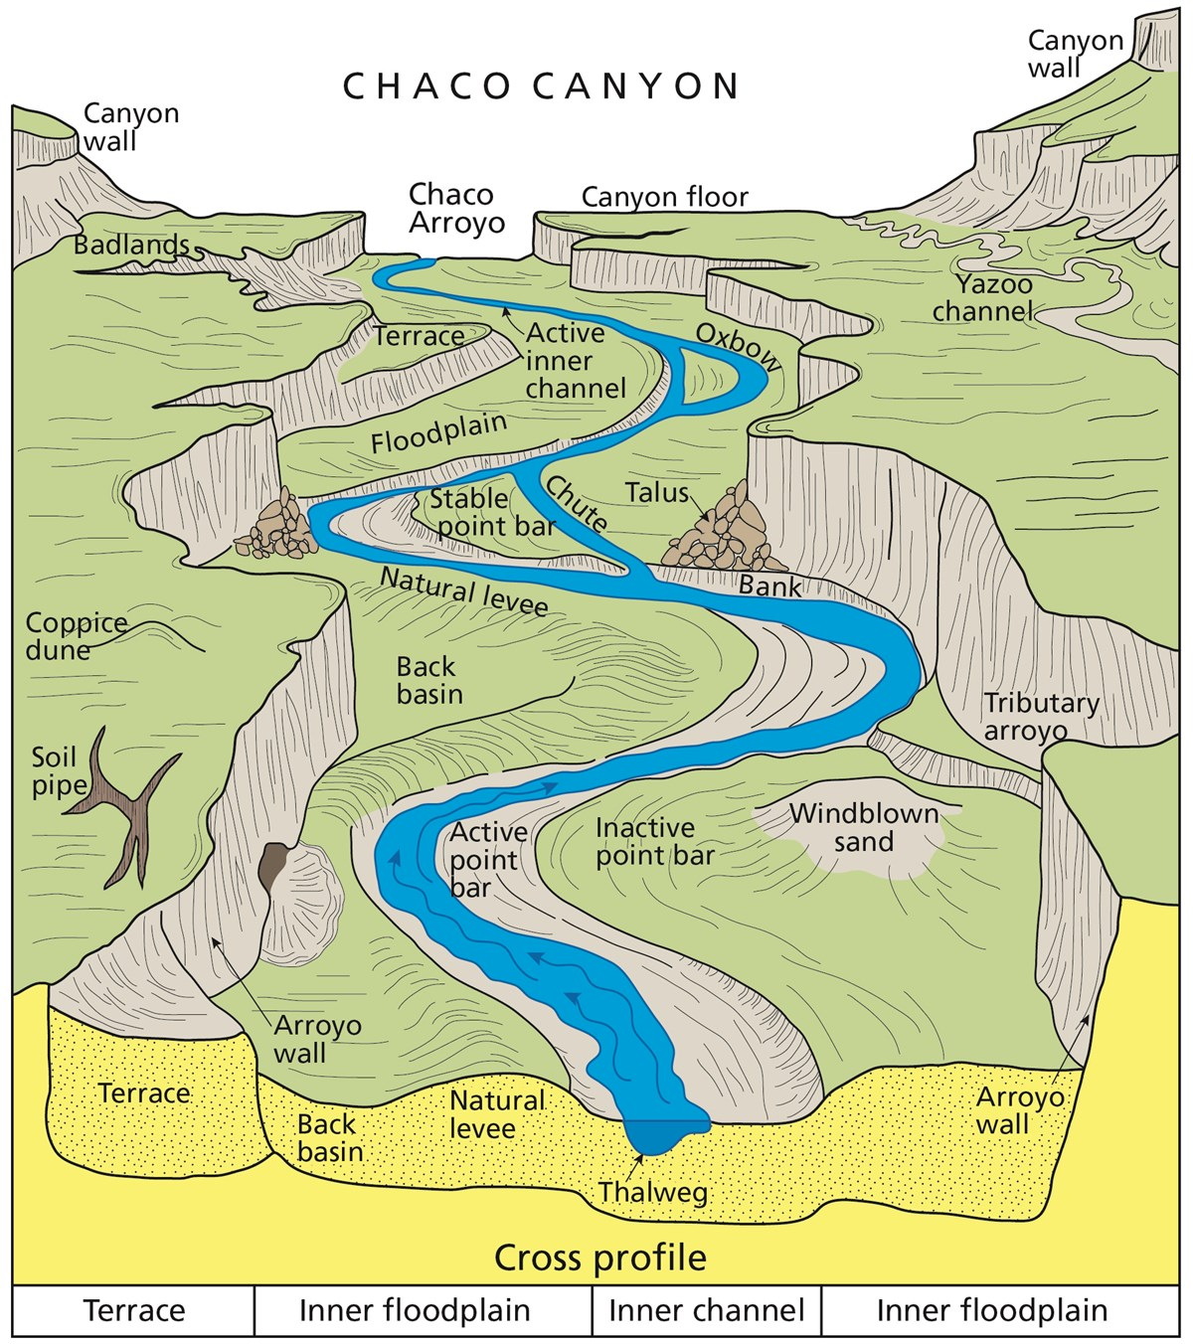
Fluvial processes shape the natural landscape
CHACO CANYON
Thalweg:最深谷底線
Levee: river bank 防洪堤
Talus:崖錐
Chute:滑梯
Tributary:支流
Arroyo:旱谷
Coppice:萌生林
Notes:
Thalweg:最深谷底線
Levee: river bank防洪堤
Talus:崖錐
Chute:滑梯
Tributary:支流
Arroyo:旱谷

Slide 12
視為系統性研究方法的自然地理區劃，定等級時無可避免地需考慮尺度(scale)，和不同尺度彼此互動(interaction)下產生的梯度(gradient)。而梯度本身將作為營力(gradient force)，其目的在消彌尺度差異。

